Slide 1
Cache Memory

Slide 2
Locality of Reference
▶ Cache memory is based on the principle of locality of reference.
Locality of Reference
▶ The references to memory tend to be confined within a few localized areas in memory
▶ Temporal Locality :If a particular memory location is referenced it is likely that same location will be referenced in the near future
▶ Spatial Locality: If a particular memory location is referenced it is likely that near by memory location will be referenced in the near future

Slide 3
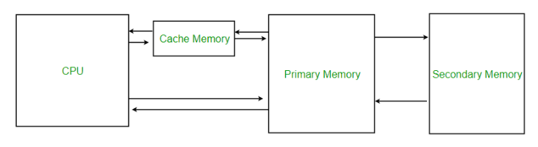
Cache Memory
▶ Cache Memory is a fast small memory placed between the CPU and main memory
▶ The cache is the fastest component in the memory hierarchy and approaches the speed of CPU components
▶ The cache memory access time is less than the access time of main memory by a factor of 5 to 10.

Slide 4
Cache Memory
▶ The fundamental idea of cache organization is that by keeping the most frequently accessed instructions and data in the fast cache memory, the average memory access time will approach the access time of the cache
▶ Although the cache is only a small fraction of the size of main memory, a large fraction of memory requests will be found in the fast cache memory because of the locality of reference property of programs

Slide 5
The basic operation of the cache
▶ When the CPU needs to access memory, the cache is examined.
▶ If the word is found in the cache, it is read from the fast memory.
▶ If the word addressed by the CPU is not found in the cache, the main memory is accessed to read the word.
▶ A block of words containing the one just accessed is then transferred from main memory to cache memory.
▶ The block size may vary from one word (the one just accessed) to about 16 words adjacent to the one just accessed.
▶ In this manner, some data are transferred to cache so that future references to memory find the required words in the fast cache memory

Slide 6
Hit Ratio
▶ The performance of cache memory is frequently measured in terms of a quantity called hit ratio.
▶ When the CPU refers to memory and finds the word in cache, it is said to produce a hit.
▶ If the word is not found in cache, it is in main memory and it counts as a miss.
▶ The ratio of the number of hits divided by the total CPU references to memory (hits plus misses) is the hit ratio.
▶ Hit Ratio= no. of hits
no . of hits+ no. of miss

Slide 7
Mapping
▶ The transformation of data from main memory to cache memory is referred to as a mapping process.
▶ Three types of mapping procedures
Associative mapping
Direct mapping
Set-associative mapping

Slide 8
Associative mapping
CPU address(15 bits)
▶ The fastest and most flexible cache organization uses an associative memory.
▶ The associative memory stores both the address and content (data) of the memory word.
▶ This permits any location in cache to store any word from main memory.
▶ A CPU address of 15 bits is placed in the argument register and the associative memory is searched for a matching address.
Argument register
Address
Data
0 1 0 0 0 | 3 4 5 0
0 2 7 7 7 | 6 7 1 0
2 2 3 4 5 | 1 2 3 4

Slide 9
Associative mapping
▶ If the address is found, the corresponding 12- bit data is read and sent to the CPU.
▶ If no match occurs, the main memory is accessed for the word. The address--data pair is then transferred to the associative cache memory.
▶ If the cache is full, an address--data pair must be displaced to make room for a pair that is needed and not presently in the cache.
▶ Different replacement algorithms like FIFO is used for this.
CPU address(15 bits)
Argument register
Address
Data
0 1 0 0 0 | 3 4 5 0
0 2 7 7 7 | 6 7 1 0
2 2 3 4 5 | 1 2 3 4

Slide 10
Direct Mapping
▶ Associative memories are expensive compared to random- access memories because of the added logic associated with each cell.
▶ Direct Mapping uses a random-access memory for the cache
▶ The CPU address of 15 bits is divided into two fields.
▶ The nine least significant bits constitute the index field and the remaining six bits form the tag field
▶ The number of bits in the index field is equal to the number of address bits required to access the cache memory.

Slide 11
Direct Mapping
▶ In the general case, there are 2^{k} words in cache memory and 2^{n} words in main memory.
▶ The n-bit memory address is divided into two fields: k bits for the index field and n - k bits for the tag field.
▶ The direct mapping cache organization uses the n-bit address to access the main memory and the k-bit index to access the cache.
6 bits
9 bits
Tag (6 bit)
00 - 63
Tag
Index
00 000
32K×12
Main memory
Address = 15 bits Data = 12 bits
000
512×12
Cache memory
Address = 9 bits Data = 12 bits
Index (9 bit)
000 - 511
Octal address
Hex Address
1FF
3F 1FF

Slide 12
Direct Mapping cache organization
▶ Each word in cache consists of the data word and its associated tag.
▶ When a new word is first brought into the cache, the tag bits are stored alongside the data bits.
▶ When the CPU generates a memory request, the index field is used for the address to access the cache.
▶ The tag field of the CPU address is compared with the tag in the word read from the cache.
Memory address
00000
Index address
000
Memory data
Tag
Data
0
1 2 2 0
2 3 4 0
3 4 5 0
4 5 6 0
5 6 7 0
6 7 1 0
00 | 1 2 2 0
02 | 6 7 1 0
00777
01000
01777
777
02000
(b) Cache memory
02777
(a) Main memory

Slide 13
Direct Mapping cache organization
▶ If the two tags match, there is a hit and the desired data word is in cache.
▶ If there is no match, there is a miss and the required word is read from main memory.
▶ It is then stored in the cache together with the new tag, replacing the previous value.
▶ The disadvantage of direct mapping is that the hit ratio can drop considerably if two or more words whose addresses have the same index but different tags are accessed repeatedly
Memory address
000000
Index address
000
Memory data
Tag
Data
1 2 2 0
2 3 4 0
3 4 5 0
4 5 6 0
5 6 7 0
6 7 1 0
00 | 1 2 2 0
02 | 6 7 1 0
00777
01000
01777
777
02000
(b) Cache memory
02777
(a) Main memory

Slide 14
Memory address
00000
Index address
000
Memory data
Tag
Data
▶
₁st
00000
0
1 2 2 0
2 3 4 0
3 4 5 0
4 5 6 0
5 6 7 0
6 7 1 0
00 | 1 2 2 0
02 | 6 7 1 0
▶ 2nd 02777
▶ 3rd 02000
▶ 4th 01000
▶ 5th 02777
00777
01000
01777
777
02000
(b) Cache memory
02777
(a) Main memory

Slide 15
Set-Associative Mapping
▶ Set-associative mapping, is an improvement over the direct mapping organization in that each word of cache can store two or more words of memory under the same index address.
▶ Each data word is stored together with its tag and the number of tag-data items in one word of cache is said to form a set.
▶ An example of a set-associative cache organization for a set size of two is shown.
▶ Each index address refers to two data words and their associated tags.
▶
Index
Tag
Data
Tag
Data
000
0 1 | 3 4 5 0 |  | 0 2 | 5 6 7 0
0 2 | 6 7 1 0 |  | 0 0 | 2 3 4 0
777

Slide 16
Set-Associative Mapping
▶ When the CPU generates a memory request, the index value of the address is used to access the cache.
▶ The tag field of the CPU address is then compared with both tags in the cache to determine if a match occurs.
▶ The comparison logic is done by an associative search of the tags in the set similar to an associative memory search: thus the name "set- associative."
▶
Index
Tag
Data
Tag
Data
000
0 1 | 3 4 5 0 |  | 0 2 | 5 6 7 0
0 2 | 6 7 1 0 |  | 0 0 | 2 3 4 0
777

Slide 17
Set-Associative Mapping
▶ The hit ratio will improve as the set size increases because more words with the same index but different tags can reside in cache.
▶ When a miss occurs in a set-associative cache and the set is full, it is necessary to replace one of the tag-data items with a new value.
▶ The most common replacement algorithms used are: random replacement, first-in, first- out (FIFO), and least recently used (LRU).
Index
Tag
Data
Tag
Data
000
0 1 | 3 4 5 0 |  | 0 2 | 5 6 7 0
0 2 | 6 7 1 0 |  | 0 0 | 2 3 4 0
777

Slide 18
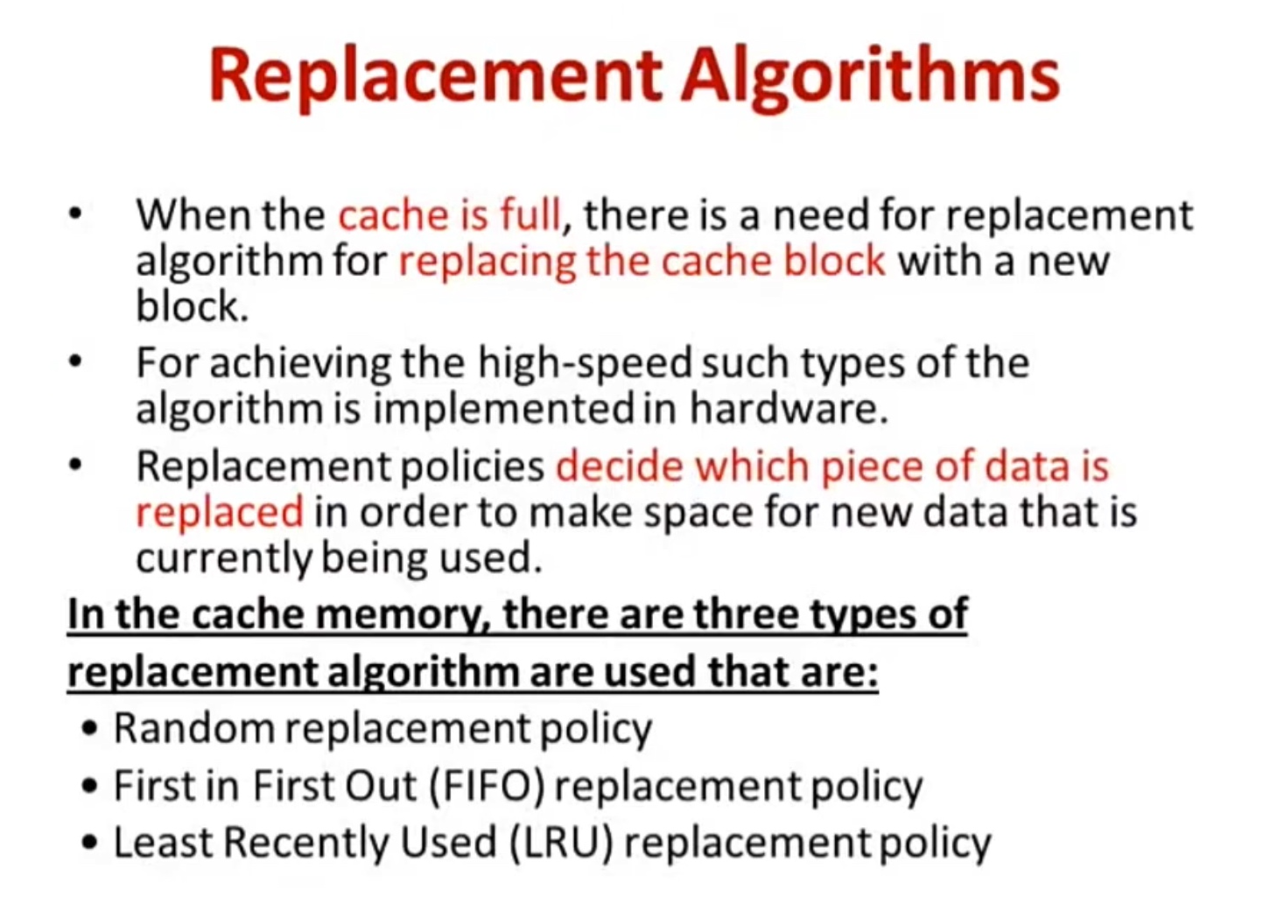

Slide 19
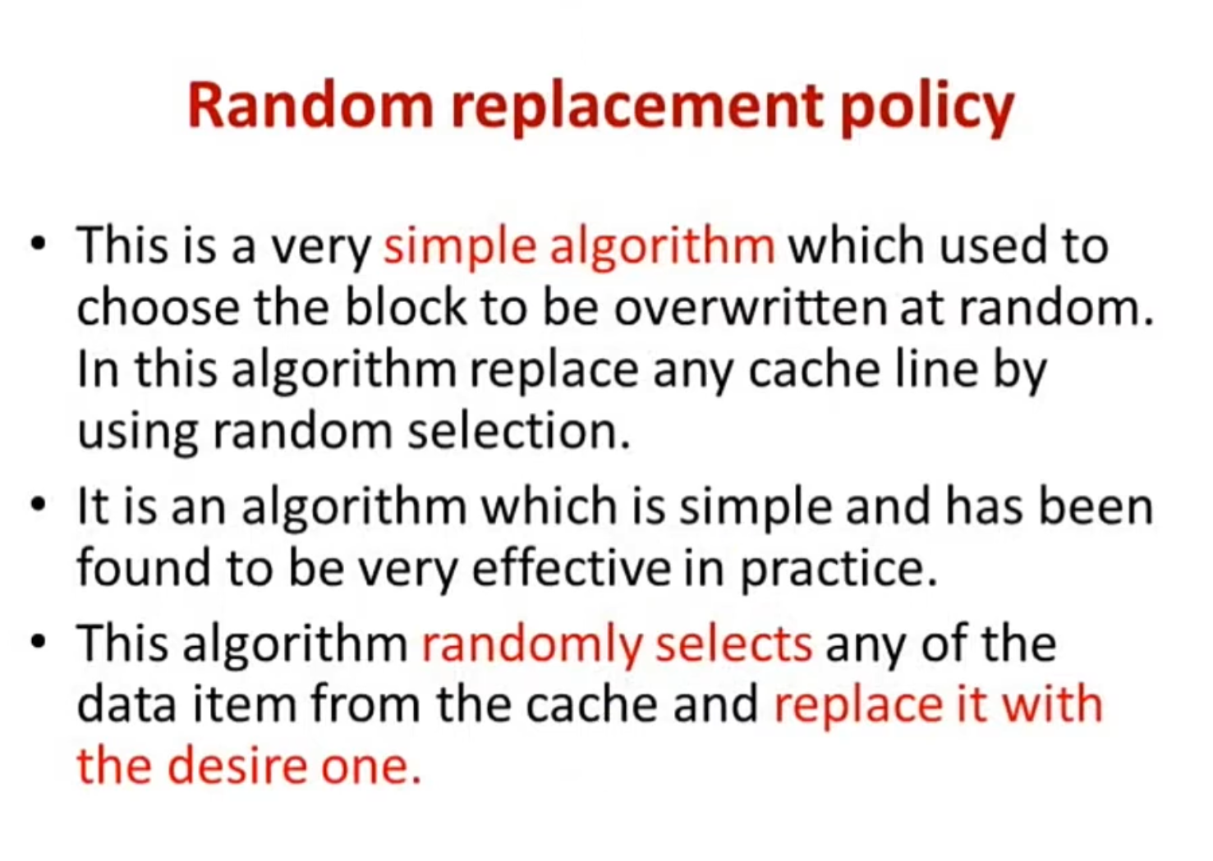

Slide 20
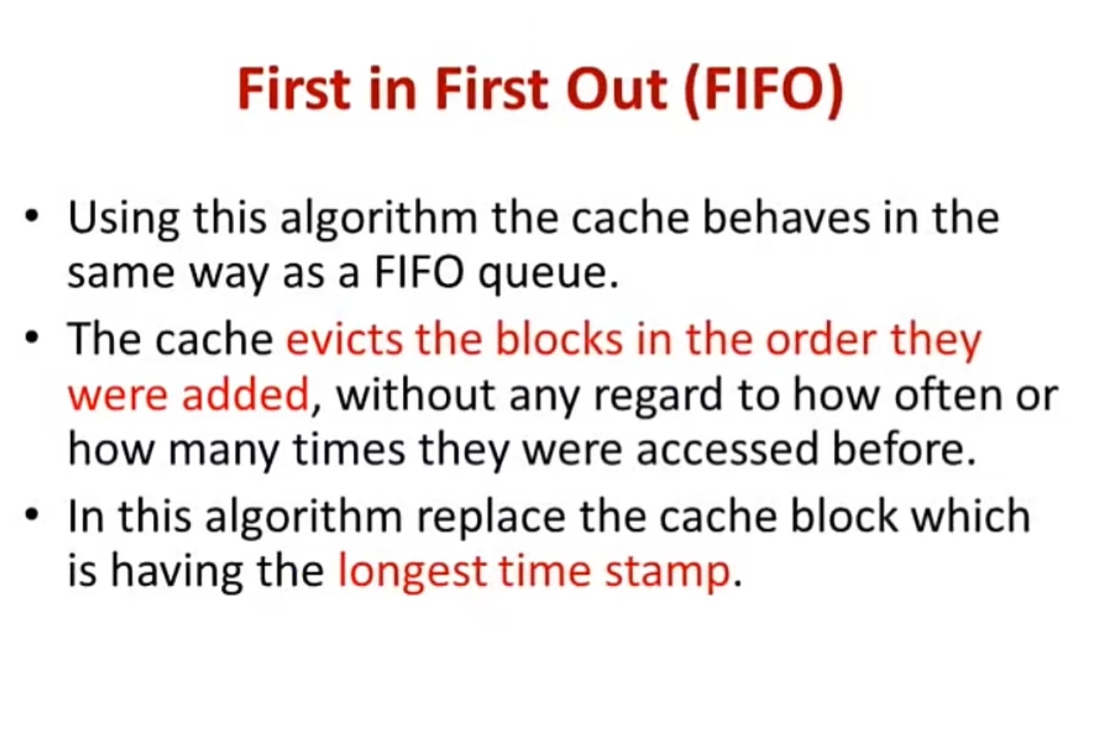

Slide 21
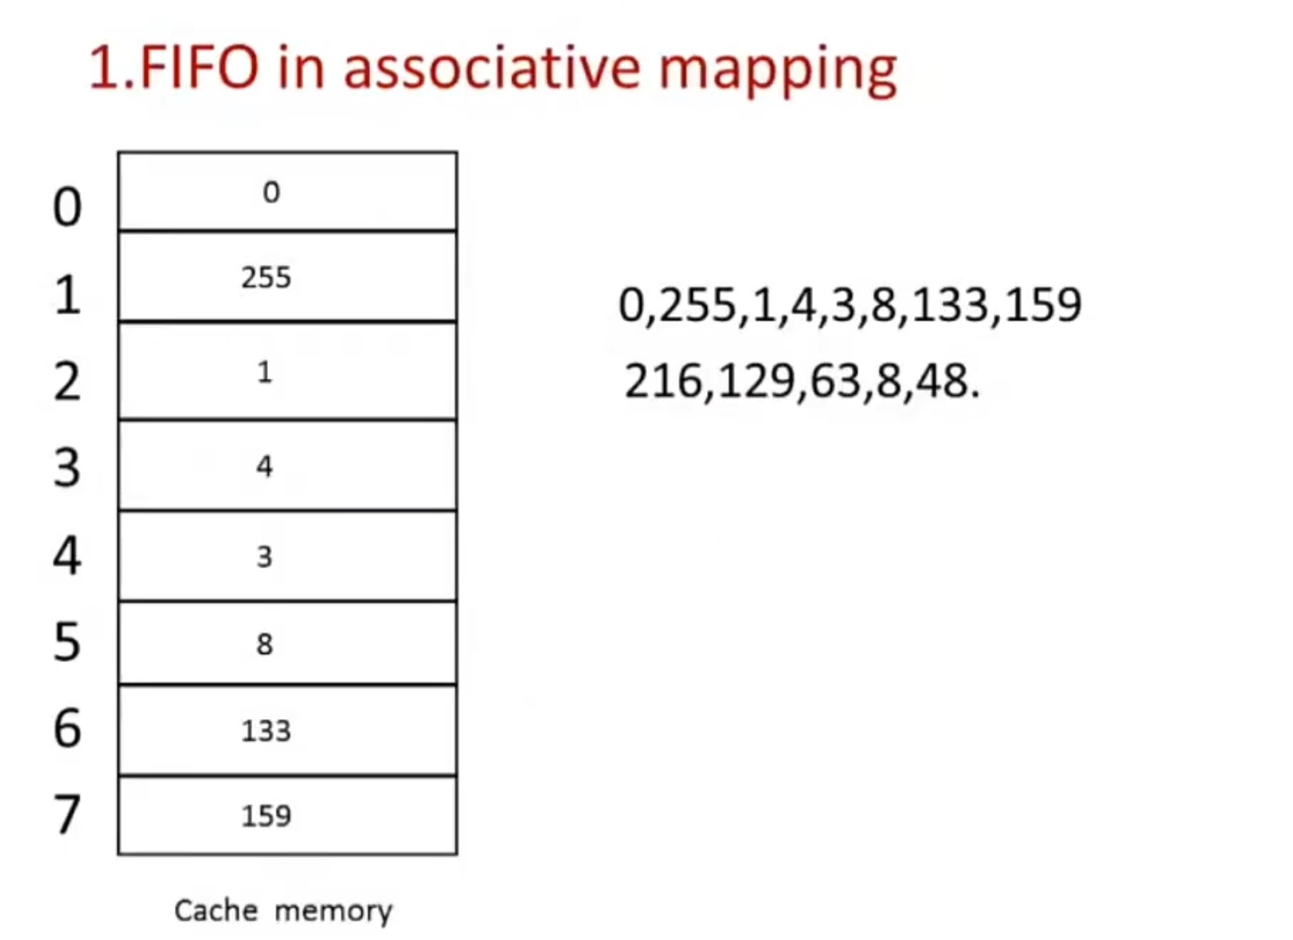

Slide 22
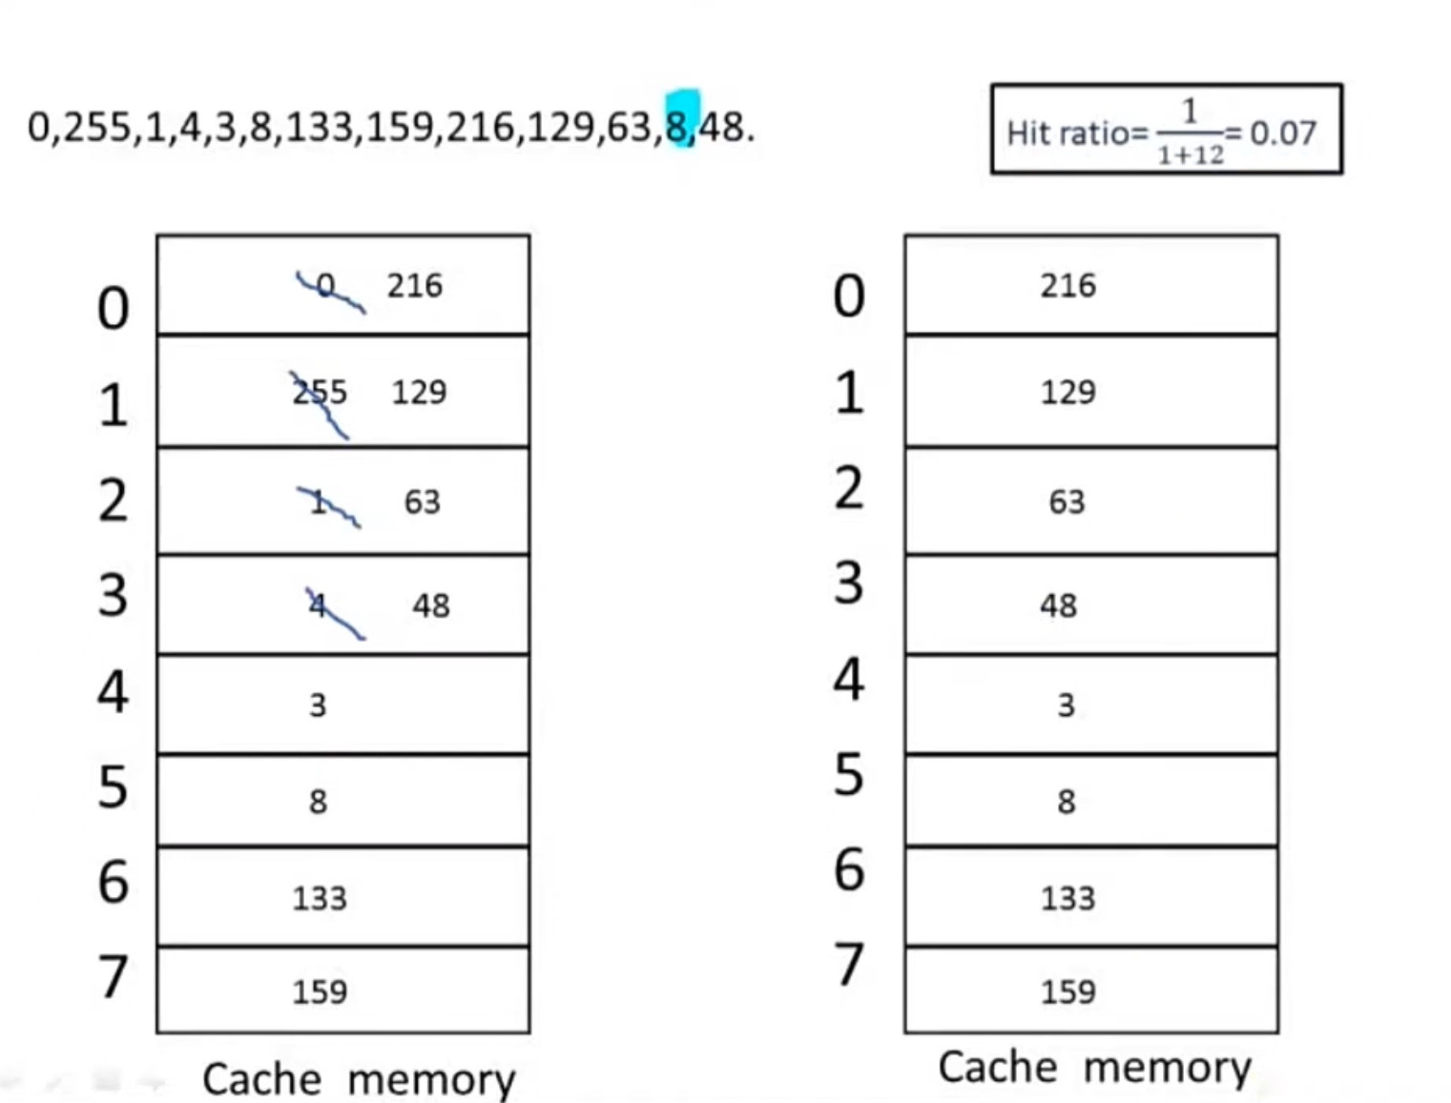

Slide 23
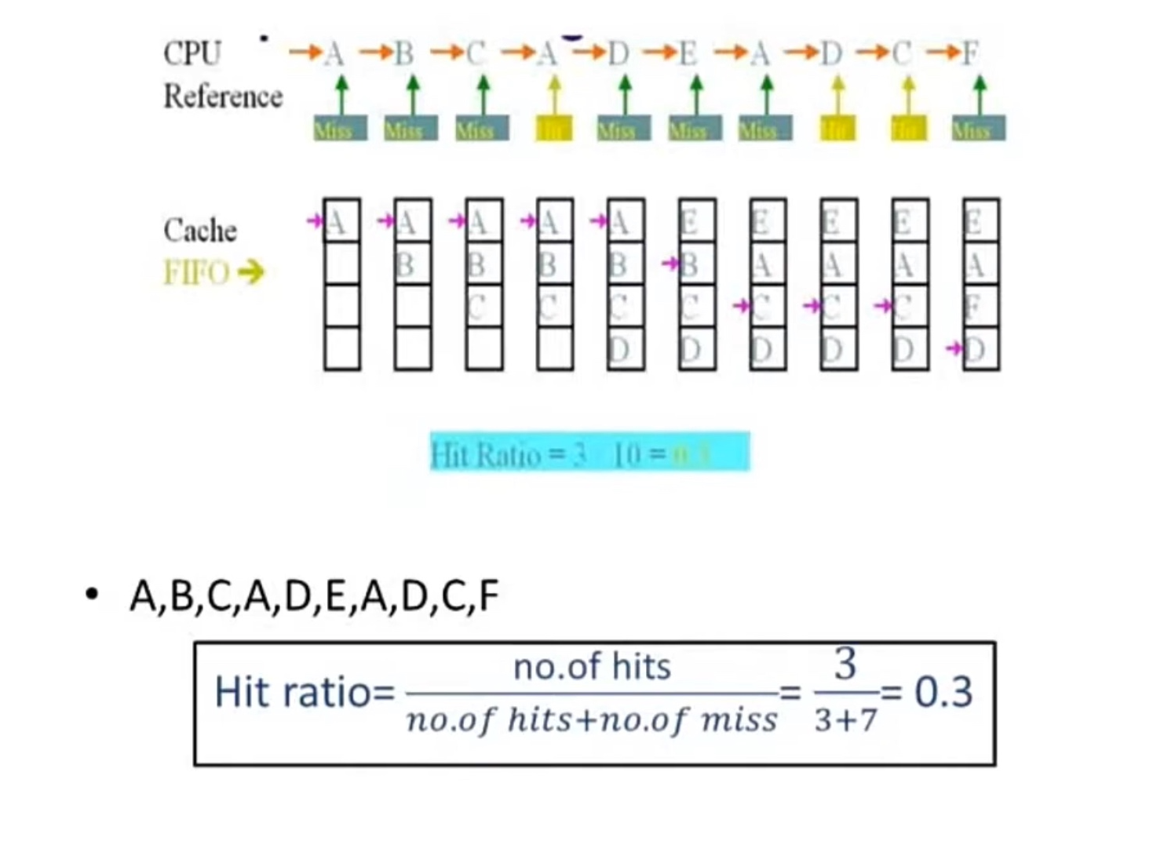

Slide 24
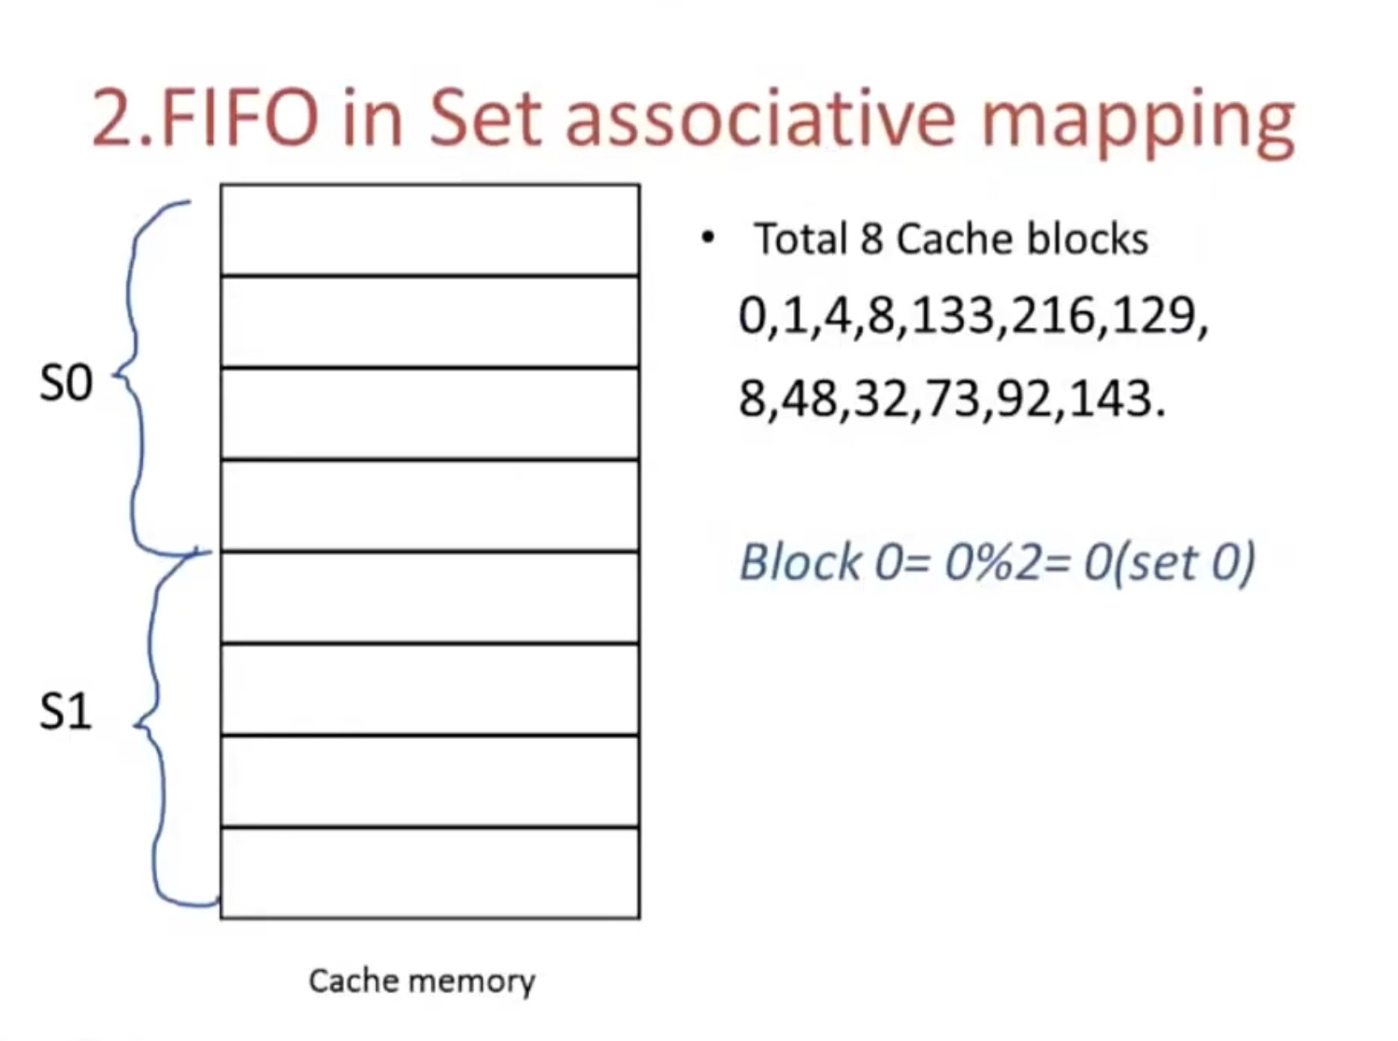

Slide 25
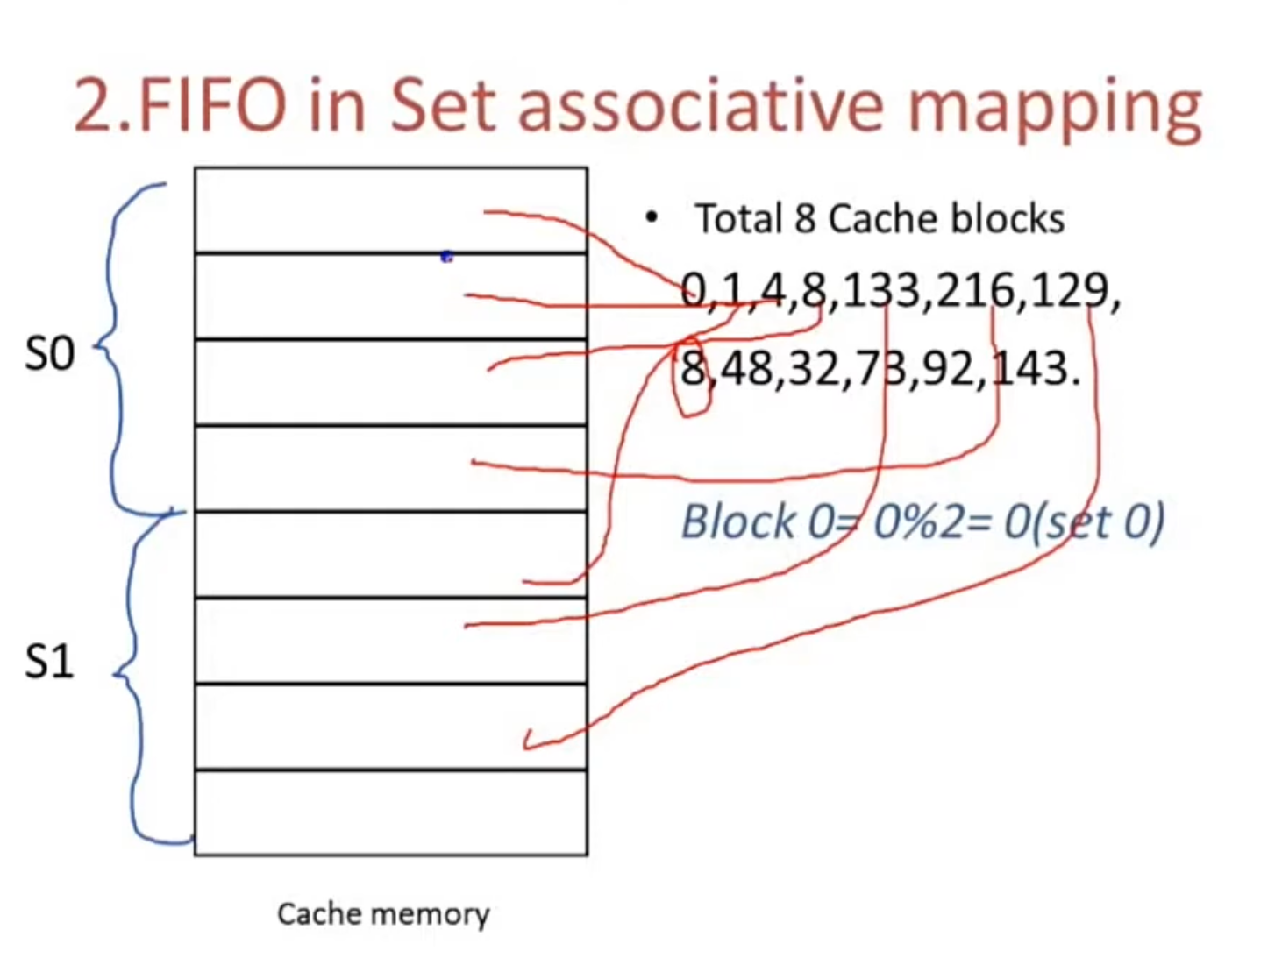

Slide 26
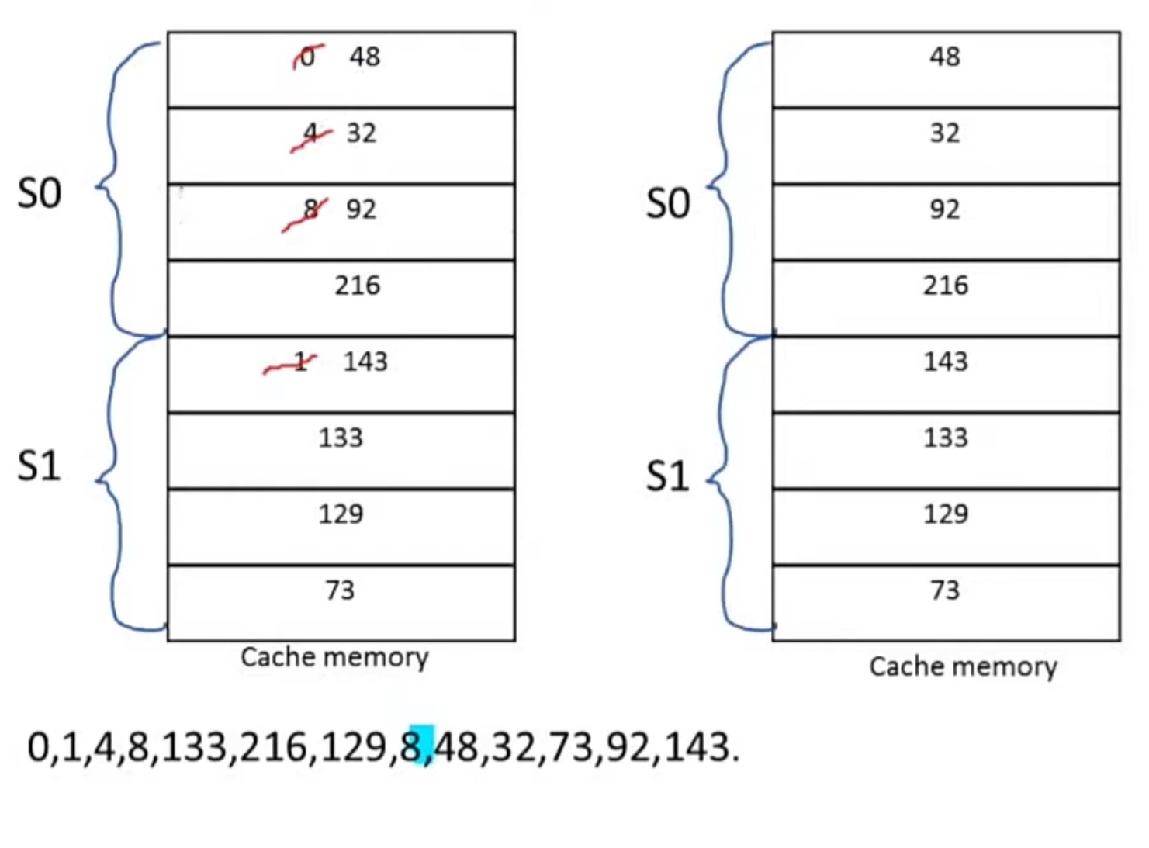

Slide 27
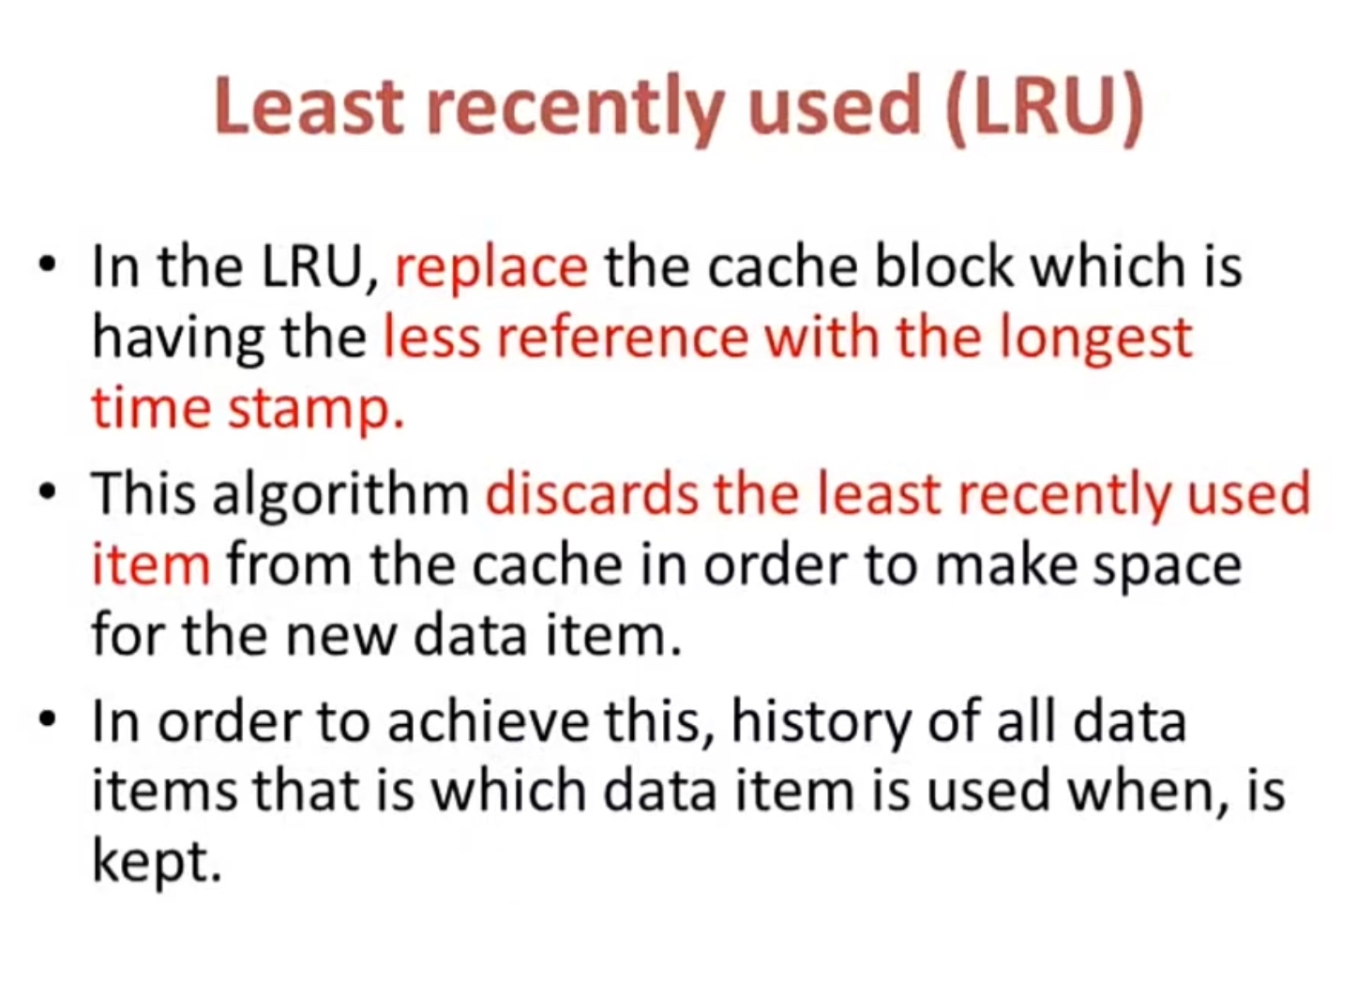

Slide 28
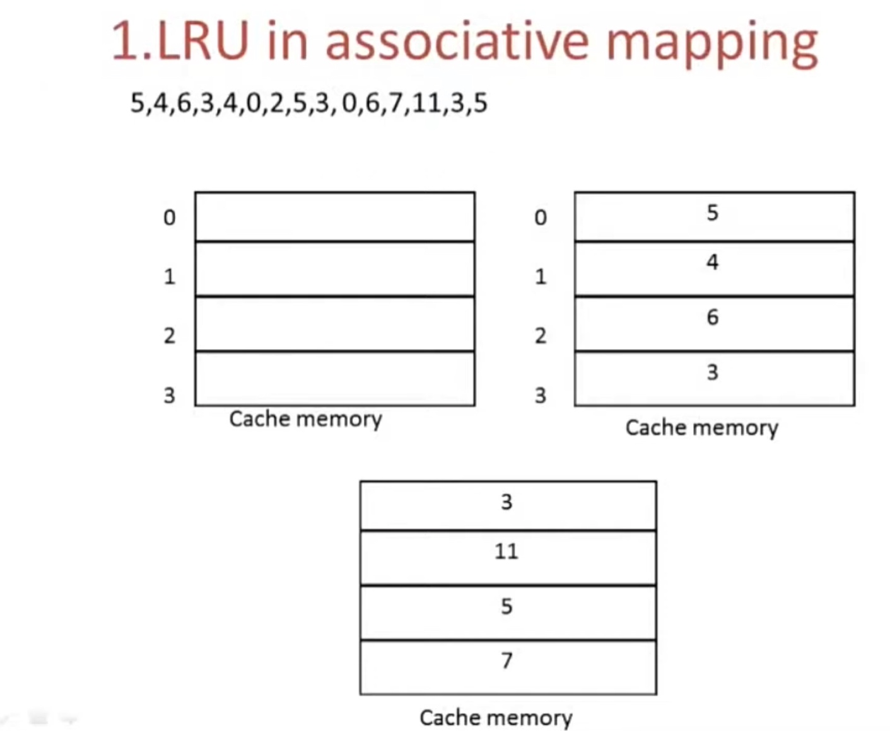

Slide 29
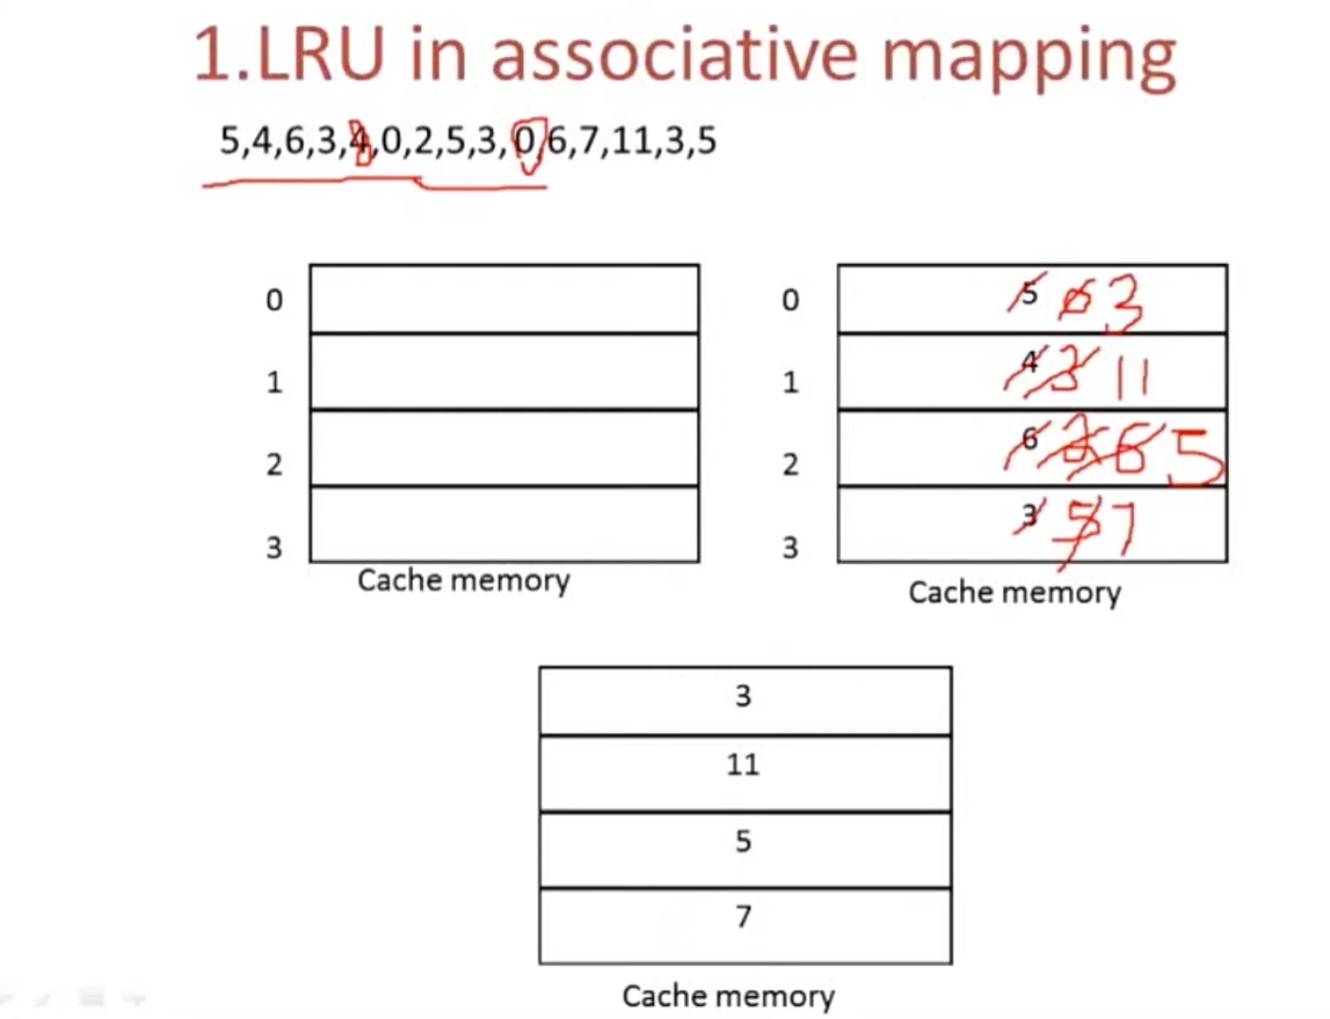

Slide 30
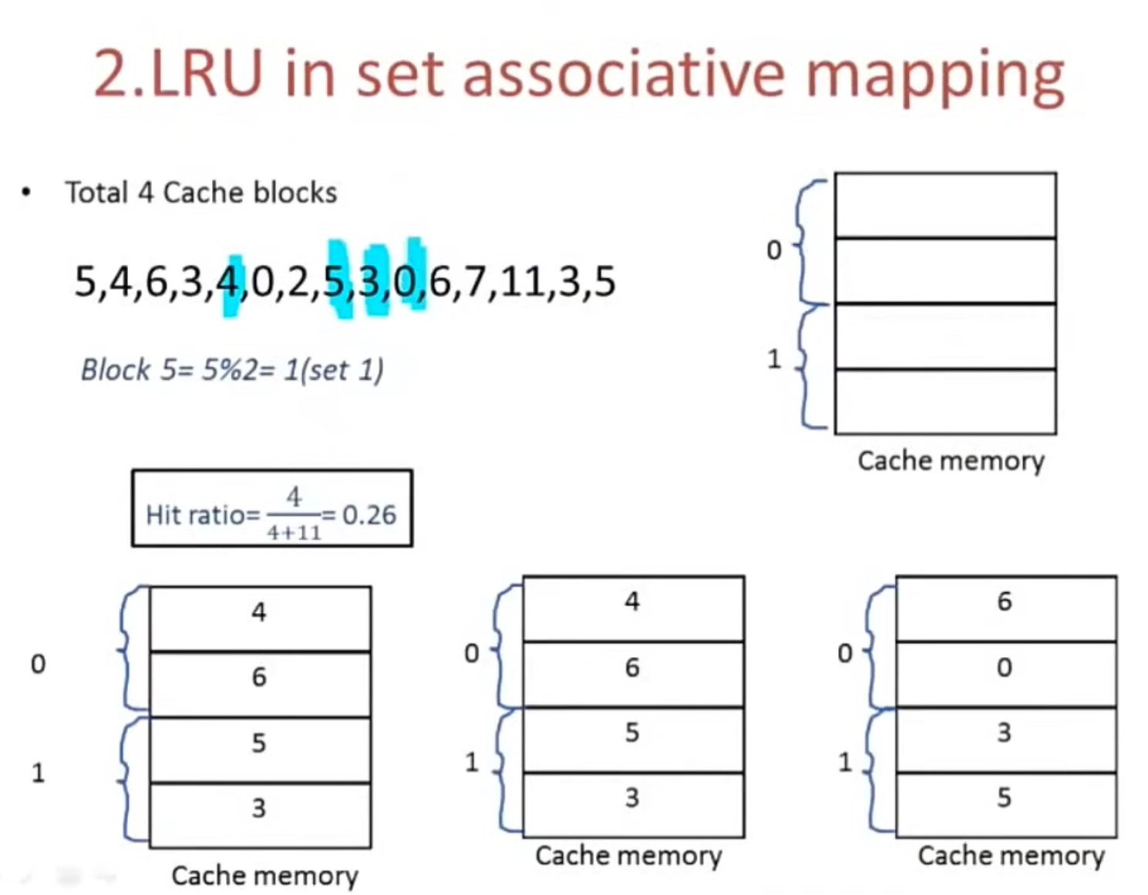

Slide 31
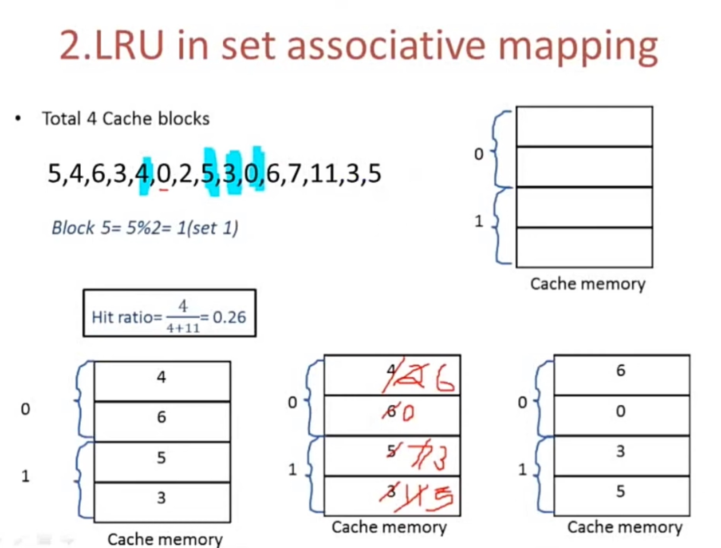

Slide 32


